Slide 1
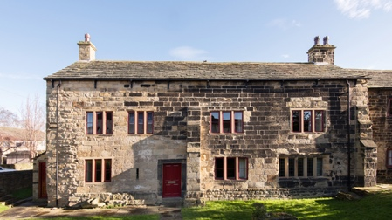
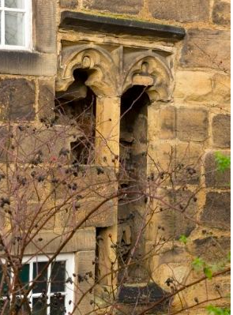
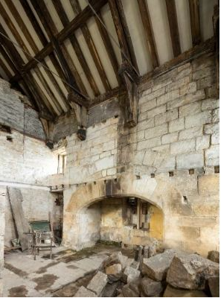
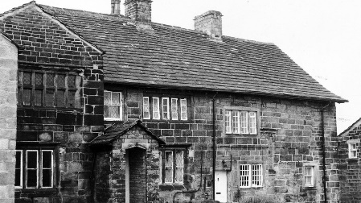
Life in Medieval England
Calverley Old Hall
Notes:
This lesson is designed to prepare pupils for learning more about Calverley Old Hall. In this lesson, we will explore England as it was when Calverley Old Hall was built, developed and lived in.
You could ask if your pupils are familiar with Calverley Old Hall; “Has anyone heard of it/seen it/ knows where it is?”

Slide 2
Medieval England
Notes:
Calverley Old Hall was first built in medieval times. What does the word “medieval” mean to you?
(Record pupils ideas on the yellow post it notes on this slide or go on to Slide 3 if pupils need prompting)

Slide 3
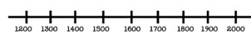
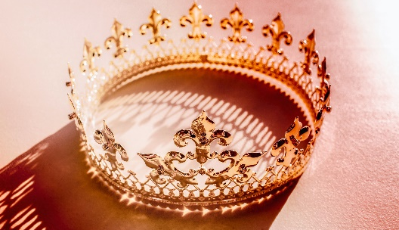
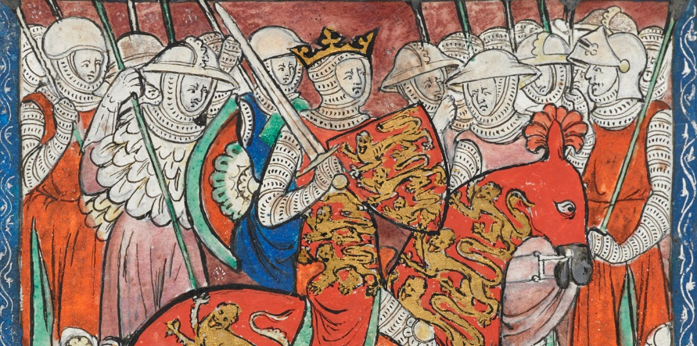
Discussion ideas
When was the medieval period?
Can you name a medieval monarch?
Can you think of any inventions, developments or famous events from medieval times?
Notes:
Prompt pupils to remember previous learning where appropriate. Use the timeline to encourage pupils to think chronologically about dates they know. Encourage children to remember royal names from today and from history e.g. William, Charles
Encourage pupils to think widely about e.g. the development of laws and parliament, inventions like the printing press or outbreaks of diseases, famous wars/battles.
Record all ideas on the previous slide’s post it notes (Slide 2).
[Image: King William I mounted, with sword and shield, accompanied by knights and soldiers. The arms of England appear on his surcoat, shield, and the trappings on his horse © The British Library Board, Cotton Claudius D. II from https://www.royal.uk/william-the-conqueror]

Slide 4
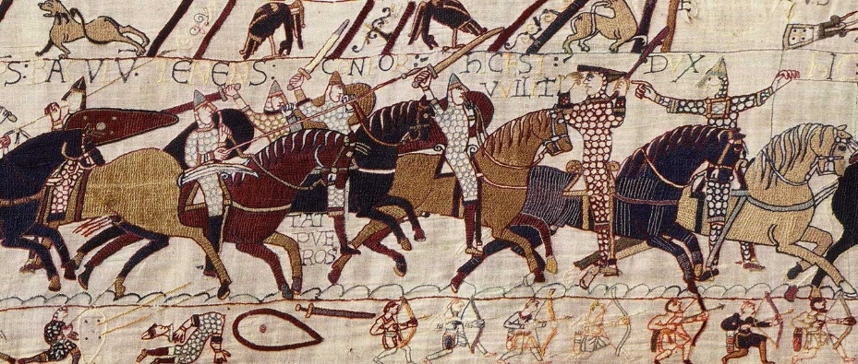
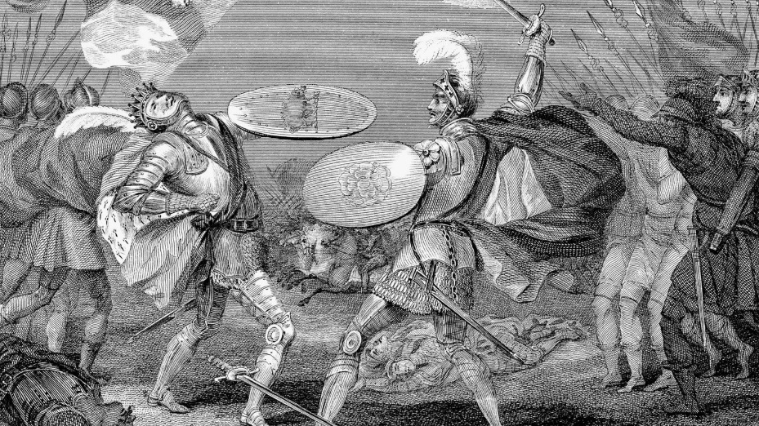
Medieval England
Battle of Hastings, 1066
Medieval describes the period in Britain from 1066, when William the Conqueror was victorious at the Battle of Hastings, until the Battle of Bosworth, when Henry Tudor became the first Tudor king, Henry VII.
Battle of Bosworth, 1485
Henry Tudor killing King Richard III in the Battle of Bosworth Field, 1485.
Notes:
This is one definition of ‘medieval Britain’. Do you think all historians would agree? Do historians always agree about history?
This definition uses battle dates. Can you think of any other ways to organise history?
Prompt children to think about other historical terms they know and their origin e.g. monarchs (Tudors/Georgians/Victorian), aspects of national life like building materials (stone age/iron age etc), or scientific discoveries (Dark Ages/ Middle Ages).
Image credits: (Top)- Battle of Hastings as taken from Bayeux Tapestry https://www.bayeuxmuseum.com/en/the-bayeux-tapestry/discover-the-bayeux-tapestry/explore-online/
Bottom- Henry Tudor killing King Richard III in the Battle of Bosworth Field, 1485. Credit: Photos.com/Jupiterimages
Accessed from https://www.britannica.com/event/Battle-of-Bosworth-Field]

Slide 5
Life in medieval England was…
Dirty
Strict
Religious
Hungry
Dangerous
Notes:
This activity can be approached in various different ways; please refer to the teaching notes.
“So what was life like in medieval England? You are now going to explore (primary and secondary) sources to find out more about life during medieval times. There are sources relating to different aspects of life in medieval England (described on this slide). Can you decide which word your sources match on the slide? In .... minutes we will come back together and present what we have found out.”

Slide 6
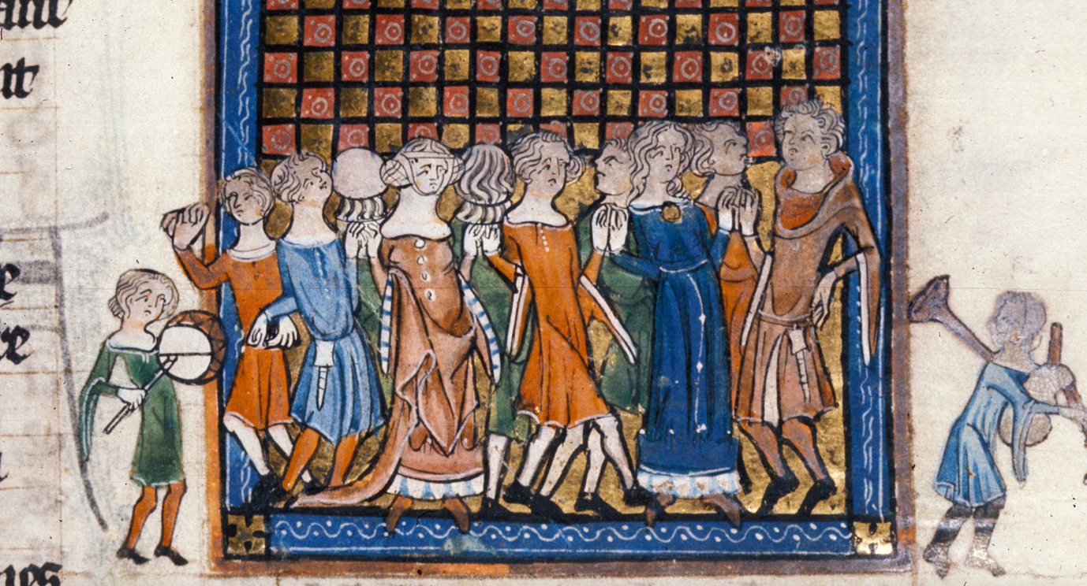
Try your own medieval dance!
Make a circle and try to keep up with this video
Notes:
Activity 2 is a dance video to provide a brain/movement break for pupils. They will have the opportunity to hear some medieval music, observe medieval clothing (costumes) and have a go themselves at medieval dancing.
[Image: British Library MS Royal 20 A XVII f. 9 accessed https://www.bl.uk/catalogues/illuminatedmanuscripts/]

Slide 7
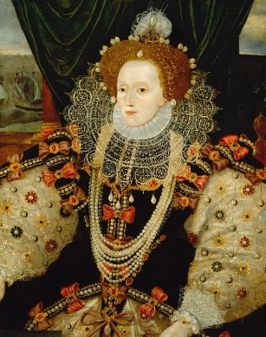
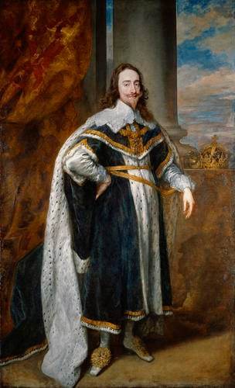
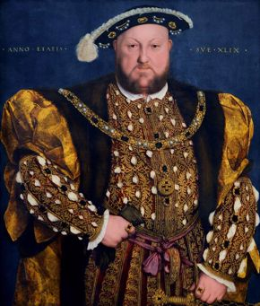
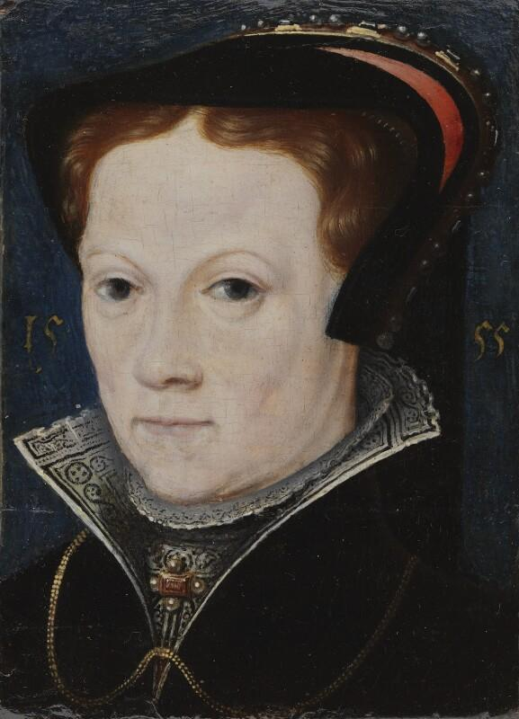
Tudors and Stuarts
Can you match these Royal portraits to their names and important facts about their reign?
This monarch established the Church of England and split from the pope and the Catholic church in Rome
This monarch tried to make England Catholic again and was called Bloody…….
This monarch lost the Civil War to the Parliamentarians
This monarch’s reign is sometimes called the Golden Age
Henry VIII
Elizabeth I
Mary I
Charles I
Notes:
So what happened next? Following the medieval period, there were the very dramatic years of Tudor and Stuart reign. Working together now, can we identify four famous monarchs from this period, and match them to one of the facts.
Activity 3: Pupils could discuss in small groups first and then share ideas, or complete the task collectively as a whole class.
[Images from top left to bottom right: Queen Elizabeth I by Unknown English artist, oil on panel, circa 1588 38 1/2 in. x 28 1/2 in. (978 mm x 724 mm), NPG 541 accessed from https://www.npg.org.uk/collections/search/portraitConservation/mw02077/Queen-Elizabeth-I.
Charles I (1600-1649) Signed and dated 1636, by ANTHONY VAN DYCK, Oil on canvas | 248.0 x 153.6 cm (support, canvas/panel/stretcher external) | RCIN 404398, accessed from https://www.rct.uk/collection/404398/charles-i-1600-1649.
Hans Holbein the Younger, Portrait of Henry VIII, 1540, oil on wood, Palazzo Barberini, Rome, accessed from https://www.mfah.org/blogs/inside-mfah/a-portrait-of-the-king-henry-viii-reigns-in-tudors-to-windsors.
Queen Mary I after Anthonis Mor (Antonio Moro), oil on panel, 1555, 3 3/8 in. x 2 1/2 in. (86 mm x 64 mm), Given by Edward Peter Jones, 1960, NPG 4174, accessed from https://www.npg.org.uk/collections/search/portrait/mw04268/Queen-Mary-I]

